Slide 1

PING PONG GAME
By
Jay Makwana
Nistha Srivastava
Palak Nath

Slide 2
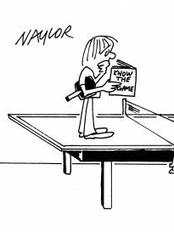
INTRODUCTION
Alternatively known as table tennis, Pong is the first game developed Al Alcorn while at Atari and was first released on November 29, 1972.
Our Model
We have created a small version of the game , PONG which was developed by Al Alcorn for our Java Mini Project using basics of Processing

Slide 3
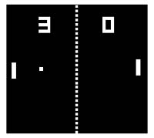
About the Game
The picture shows how Pong simulates the traditional real-life table tennis game where the player must hit and return a ball back to the other player.
If a player misses the ball, the opposing player scores a point.

Slide 4

Devices Used to Play the game
Our game can run on any Computer supporting java or processing.
KEYS USED TO HIT THE BALL
FOR PLAYER 1
KEY ‘W’- Going Up
KEY ‘S’ – Going Down
FOR PLAYER 2
KEY ‘UP’ – Going Up
KEY ‘DOWN’ – Going Down

Slide 5
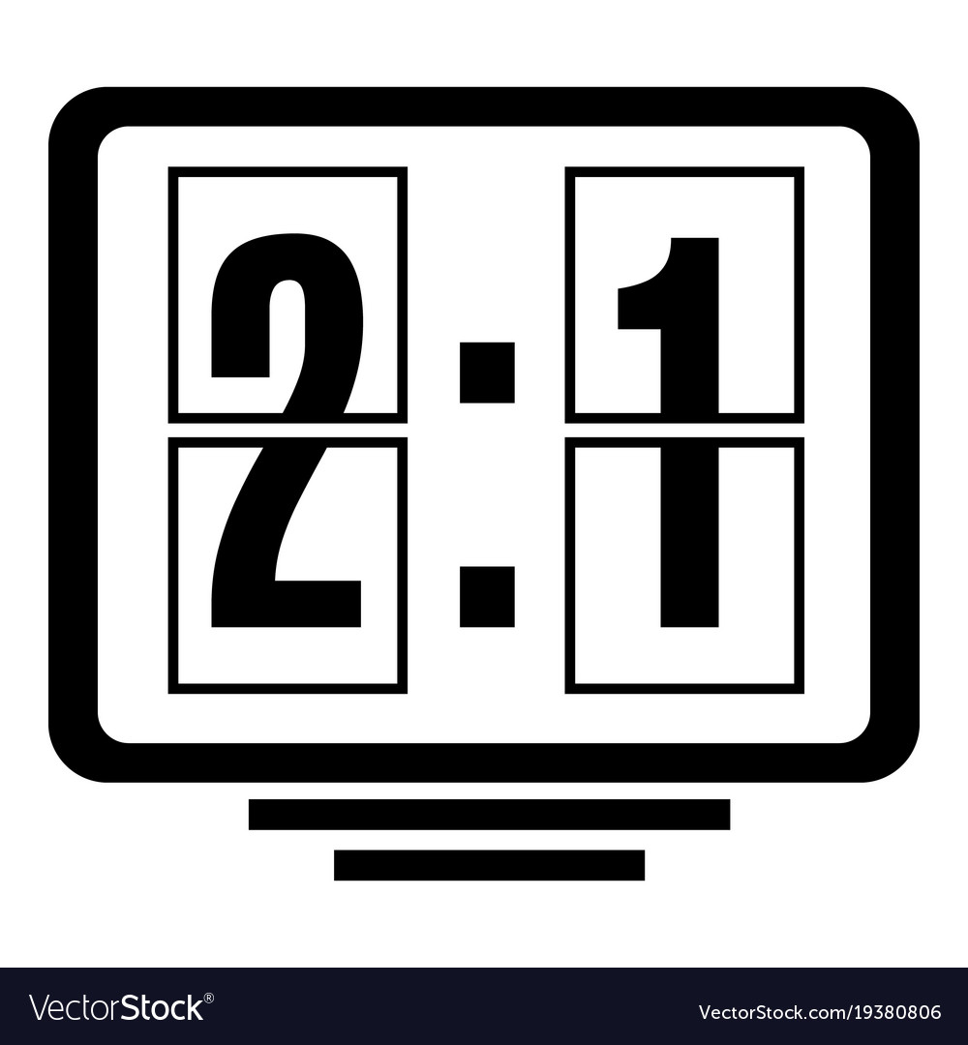
Rules to Play
The ball moves from one player’s side to the other player’s side
All a player has to do is hit that ball using the bar(racket) by moving the keys
If a player misses the ball and it touches the wall of his side, the opposing player scores a point.
If a player , suppose player A scores 3 such points , he /she wins the game.

Slide 6

CODE

Slide 7
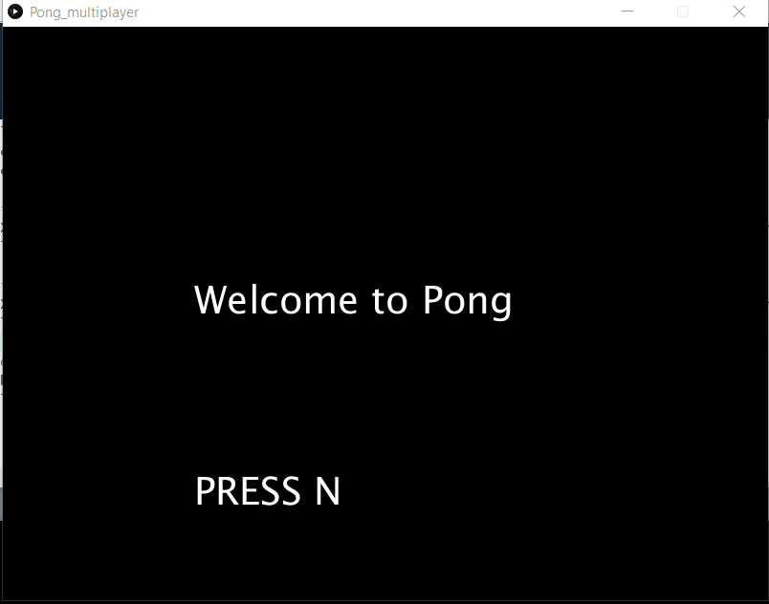
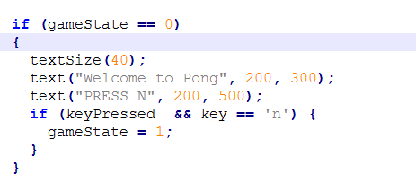
3 States Of the Game
Game State 0 :
State 0 shows Welcome Page where we have used a the predefined Function called keypressed() so when we click any key on the keyboard ,the keypressed() function returns 1 and if the keypressed() returns 1 and the pressed key is ‘n’ ,
Game State moves from 0 to 1.
Output Screen
CODE

Slide 8
SETUP
Setup consists of all the variables used during the code.
Size(800,600) → This represents the size of the canvas formed for the game.
Smooth() →
Paddle width and height are the width and height of the rectangles at both the sides which stops the ball from touching the boundary of the canvas.
p1PosY ,p2PosY ,p1PosX p2PosX → are the coordinates of the 2 rectangles respectively.
Player speed →
ballPosX , ballPosY → They are the coordinates of the center of the ball that is being used in the game,

Slide 9
CONT…
ballVelocityX ; ballVelocityY → These store the velocity with which the ball will move in x and y directions respectively.
ballSize → This variable stores the radius of the ball.
upPressed , downPressed → These are the Boolean variables which will be used by player 2 to move its paddle up and down to save the ball from hitting the boundary
wPressed , sPressed → These are the Boolean variables which will be used by player 1 to move its paddle up and down to save the ball from hitting the boundary
maxScore→ This is the maximum which decides the winner of the game. Whichever player will score this first will be declared as winner.
p1Score , p2Score→ These store the scores of the player1 and player2 respectively.

Slide 10
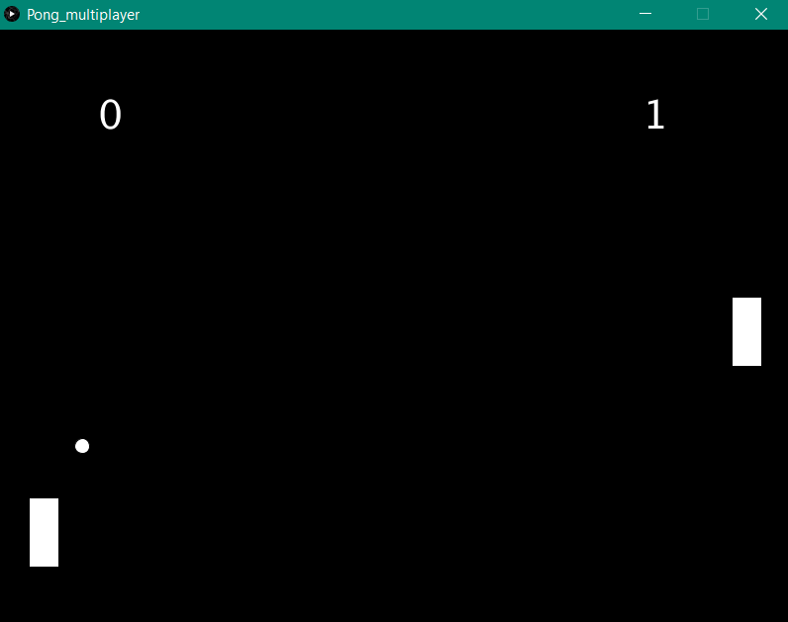
Game State 1 :
State 1 shows the state when we are actually in the game.
Here we each player has a paddle of (70*30 pixels) to save the ball from hitting their sides.
These paddles move up and down via certain keys on the keyboard.
Whenever the ball hits either of the paddles ,its speed increases in the x direction.
If a player misses the ball, the opposing player scores a point
The max score for any player is 3 and whenever either of the player reaches 3 , that player wins and the
Game State moves from 1 to 2.
Output

Slide 11
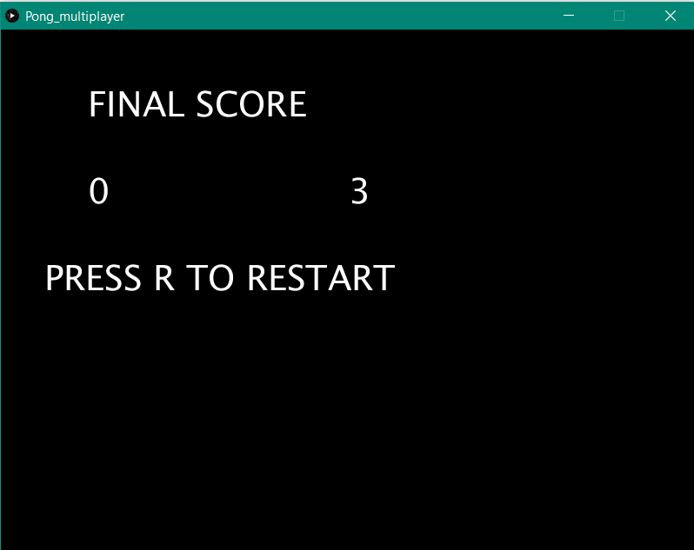
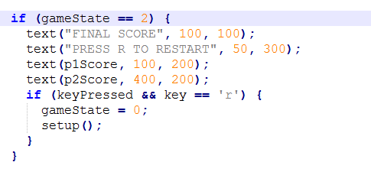
Game State 2 :
The Ending Page which displays the winner and final score of the two players .
It also asks the user if he wants to restart (by pressing R)
Similar to keypressed function in Game State 1,
The keypressed() function returns 1 and if the keypressed() returns 1 and the pressed key is ‘R’
Game State moves from 2 to 0
OUTPUT
CODE

Slide 12

The ball will bounce as follows:
If it hits the region of the paddles on both sides ( i.e. p1x and p1x + paddleWidth for X axis and p1y and p1y + paddleLength ) then the ball bounces back in negative direction with speed increased slightly ( i.e. multiplied by -1.4). Similarly for the paddle for p2.
Secondly, if it’s a miss, i.e. it hits the left or right boundary of the output wall, i.e. ( ballx > width and ballx < 0) then the ball be reset randomly anywhere to start the next round until one of the player reaches maximum score.
Lastly if the ball hits up or down bottom of the output wall, then y coordinates of ball will be multiplied by 1 so that it travels in the negative direction with same speed as it was before.
BOUNCING

Slide 13
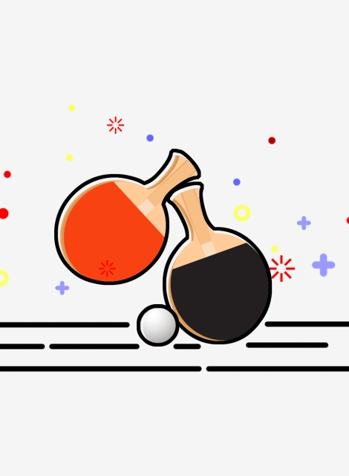
Explaining Key Pressed and Key Releasing
KEYPRESSED()
It is a Function which is a predefined function that gives output as TRUE / 1 if and key is pressed on the keyboard.
If any key is pressed , it sees which key is pressed according to that it moves the Paddle in that specific direction
KEYRELEASE();
This function is to insure that the rectangle slab i.e. paddle does not keep moving in a particular direction after key is pressed once,
It will move only till the key is being presses, as soon as it will be released.
.

Slide 14

FUN FACT "Pong" was originally meant only as a training exercise for a new gaming developer at Atari, Allan Alcorn, and wasn't intended to be released as a consumer product.

Slide 15
Bibliography
https://gizmodo.com/pong-was-never-supposed-to-be-released-to-the-public-1609521997
https://processing.org/
https://www.google.com/imghp?hl=en
https://www.computerhope.com/jargon/p/pingpong.htm

Slide 16

THANK YOU!

